Slide 1
Distribution Channels
Canon Unguren, Aiden Felt

Slide 2
Introduction
Physical media is a distribution method that include physical items such as nintendo cards and disks, digital downloads is wehn games are downloaded onto individual devices, and certain streaming services allow people to directly stream, or connect, and play those. It is important to have multiple streaming services because it allows options for both players and developers. They can play games for their specific requirements and situations, and developers can post games that fit there code and needs.

Slide 3
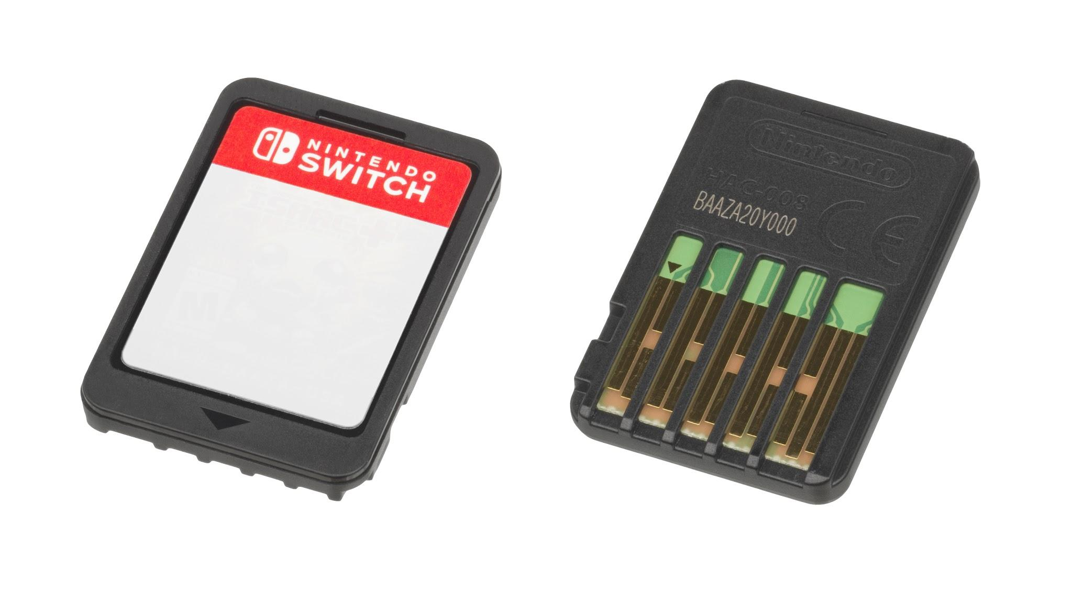
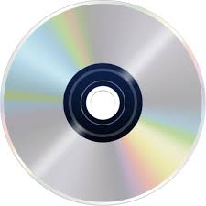
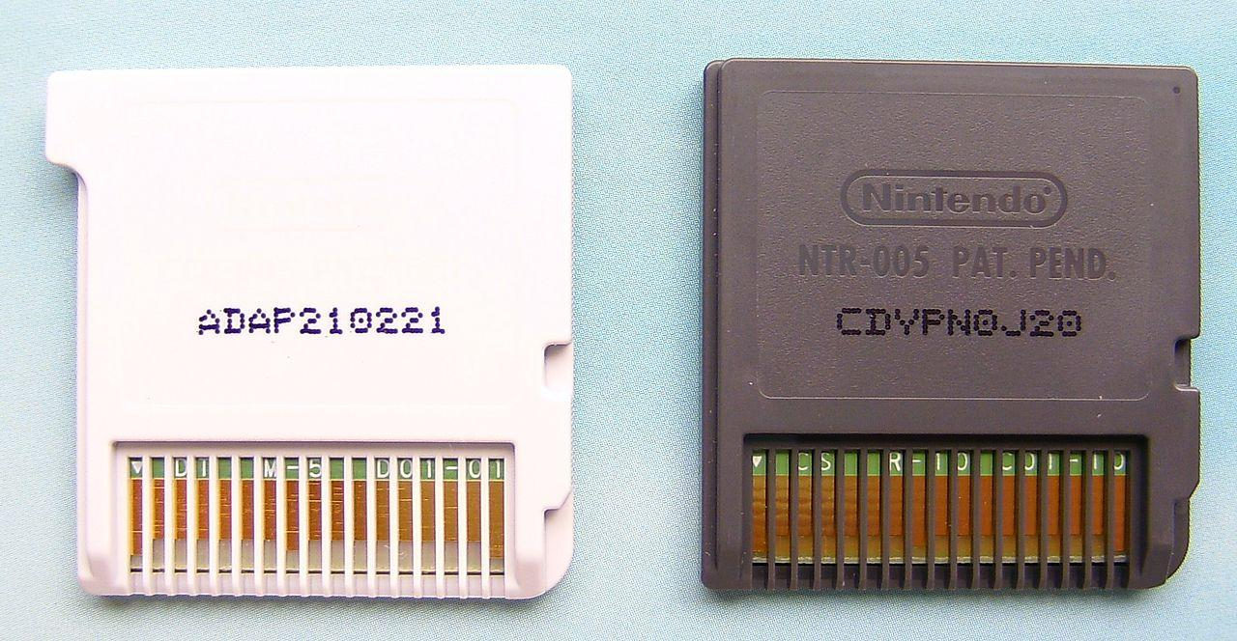
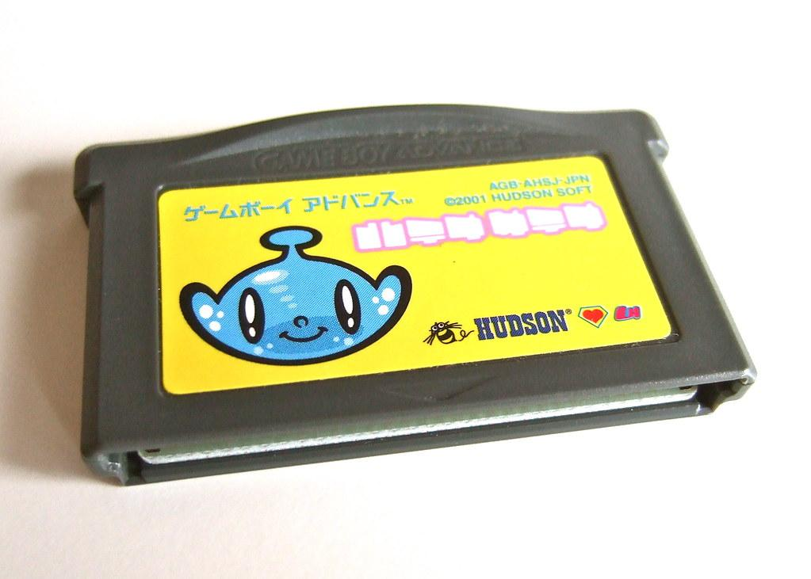
Physical Media By Canon Unguren
Physical media is a physical copy of the game, you put it into the game console and it reads the data. There is generally only one game per cartridge/disk. Many different consoles choose their own way to make physical media.
Examples: Discs, Cartridges, Game Pak, game cards, SD cards
Benefits:
Cover Art
You own it forever
No internet needed
Usable in more than one game console
Drawbacks:
Can be broken or lost
Takes up space (Both physical and in your console storage)
Progress can’t be transferred to another console

Slide 4


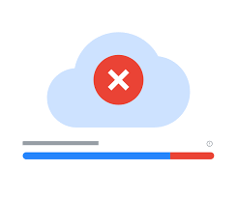
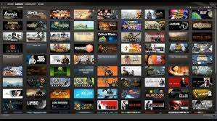
Digital Downloads Paul Tokhtuev
They are usually a site or a application with a variety of games to download. You can search up games to download and purchase. Some games will have to be purchased before you can download the game but that is up to the developer. Otherwise you can just download the game.
Examples: Steam, Epic game store, Nintendo Eshop, Itch.io.
Pros
Variety
Easily accessible
Live service
Cons
Wifi dependent for download
Storage requirement
Not actually owning the game

Slide 5
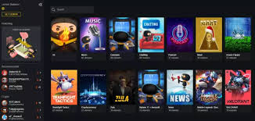
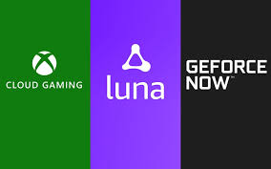
Streaming Services By Aiden Felt
Streaming services allow players to stream games directly to devices without download and no need for high end software. It is a combination of availability within PC, mobile, and consols. They are often easy to get and play, without a large amount of issues that come with downloading games.
Examples: Xbox Cloud, Playstation Plus, Steam Deck and Link,
Pros:
Large Audience
Device Flexibility
Reduced Piracy
Instant Play Convenience
Potential funding and Support
No High End Software
Cons:
High Optimization and Certification Cost
Revenue Splits
Platform Risks
Visibility Competition
Performance Issues
Ongoing maintenance

Slide 6
Platform-Specific Analysis FOR AXL WHO IS NOT HERE

Slide 7


Apple App Store/Microsoft Store Oskar Szajnuk
The Apple App Store and the Microsoft Store are both default installation methods for the Apple and Windows systems respectively. Apple’s store is exclusively for mobile devices, although has a high level of quality control and requires a $99 yearly fee. Microsoft is across the most popular computer operating system, Windows. However, Microsoft is also linked to Xbox, giving it integration with Xbox’s popular subscription service, Xbox Game Pass. Since it’s spread across multiple systems, it gives the game uploaders cross-play options.
Apple Pros
Quality control
Large audience
Game Center
Apple Cons
$99 fee
Limited hardware
High competition
Microsoft Pros
Cross-platform
Xbox integration
Game Pass exposure
Microsoft Cons
Lower quality control
Flooded with bad games
Smaller audience

Slide 8
Conclusion
Our group is going to target Digital Downloads first for many reasons. First off, it is cheaper than all of the other ways and is free most of the time. It is also very simple to upload your game and if it is a good game it will become popular and start to make money. In specific we are hoping to upload our game to Itch because it is free to upload and while people can play for free they can also give us money.

